Slide 1
Analysis of uber ridership data
MANALI RUCHANDANI – 18162121030
JINESH SHAH - 18162121034

Slide 2
ABSTRACT
Customers are often dissatisfied with traditional cab companies because of their high prices and long waiting time and hence can exploit new and big markets.
Uber, till now has made its position in market for it’s good service, low price and quick pick-ups.
We can analyze and calculate revenue, avg. speed of a single trip, demand for trips per day based on the given dataset which will help us in analyzing their marketing strategy and how likely is the company willing to make profit in upcoming years.
We can internally analyze how the company has grown since starting till now, which factors affects their growth in market.
We can also compare their marketing with other taxis and cabs and conclude why uber’s marketing strategy is better than other taxis.

Slide 3
Aim
This project aims to analyse and visualize the market of uber’s ridership and their demand based on the time period.
Characterize the demand based on identified patterns in the time series.
Estimate the value of the NYC market for Uber, and its revenue growth.
Other insights about the usage of the service.
Attempt to predict the demand growth beyond 2015.

Slide 4
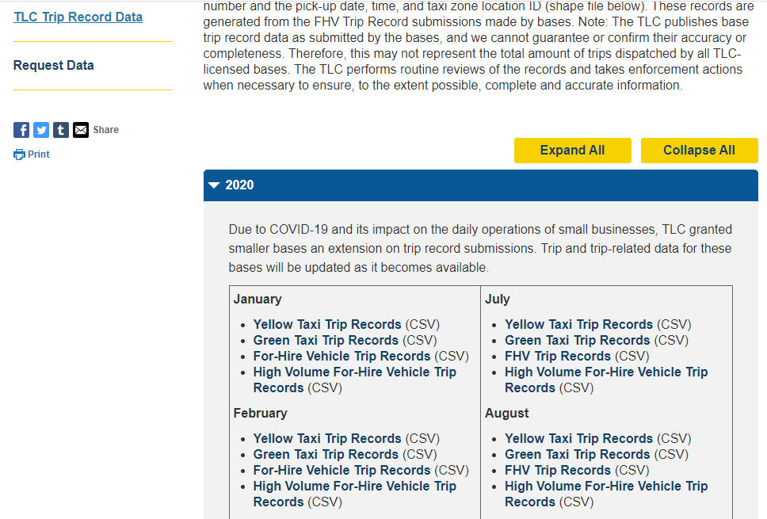
Dataset reference
TLC Trip Record Data

Slide 5
Tools and technologies
Jupyter notebook (Python 2.7 kernel)
Python libraries:
Numpy
Pandas
Matplotlib
seaborn

Slide 6
Data pre-processing, cleaning & extraction
TASK-1: Check for the unique IDs and rows to identify if there are any duplicate rows.
Result - No duplicate rows
TASK-2: Checked for the unique origin and destination codes.
Result - 28 unique origin codes & 30 unique destination codes.
TASK-3: Checked if there are any missing destination, trip duration, trip distance fields in order to remove them if needed.
Result - There are 38 records in with missing trip distance and trip duration fields but none of them have missing destination

Slide 7
cont..
TASK-4: The data/time column was first in string format, but to extract meaningful data, convert it into a date-time format (yy-mm-dd hh:mm:ss).
TASK-5: Created a separate column with the date, without time. Further separated columns based on month, days, hour, weekday.

Slide 8
Cont..
Task-6: Get a count of weekdays uber rides.
Task-7: Among all the unique durations, check how many represent >= 10h of duration.
Task-8: Check for the most unusual strings for trip durations.
Result - 7 unusual entries.
Task-9: Transform the trip duration string into trip duration in minutes.
Task-10: Get the origin-destination pair and find the mean distance and duration to cover that particular trip.

Slide 9
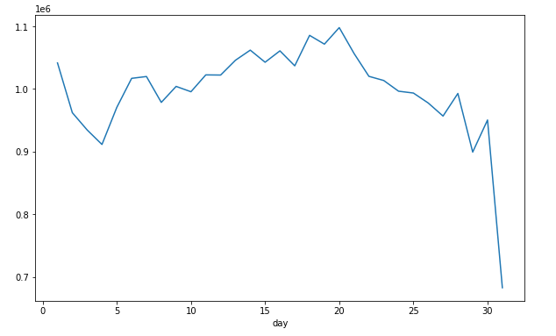
Analysis of daily frequency of uber ridership of a particular month
Output: Peakest day - 20th with 1098061 rides.

Slide 10
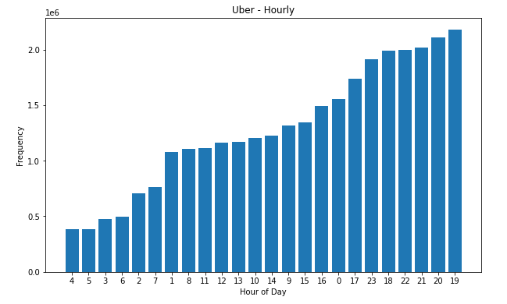
Hourly frequency analysis of uber ridership
OUTPUT: Peakest hour - 7pm/8pm

Slide 11
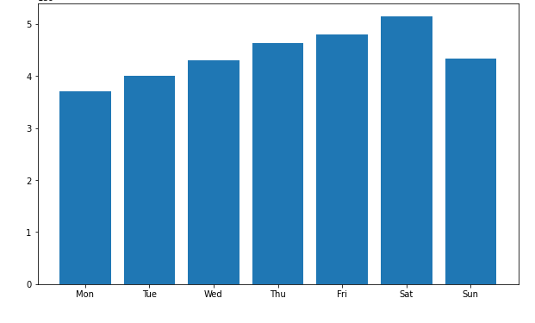
Weekly Analysis
Peakest week with max. Uber rides - saturday(weekend)

Slide 12
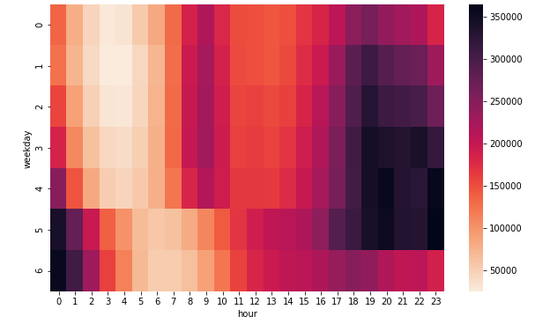
Cross Analysis of WeekDay and Hour
On weekends, highest peak is 10pm-11pm. Whereas on weekdays, highest peak is around 7-8pm

Slide 13
Calculate average speed for each trip
To help understanding the outliers (like trips with duration >10h)
Avg. speed (mph) = trip_distance/duration_min
Any insights that we can learn from the distance travelled per trip?
What is the mean time and distance to destination from the most popular pick up location?

Slide 14
Calculate Estimated Revenue per Trip.
Estimated Monthly Base Revenue: how much was the NYC market worth in the period?
Month over Month Base Revenue Growth: how fast has Uber grown in the period?
Cumulative revenue growth percentage

Slide 15
Uber’s Base revenue and Gross margin
Over the time period of 2014-2015 ------
Base Revenue: $595M
Uber's Base Gross Margin: $148,766,619

Slide 16
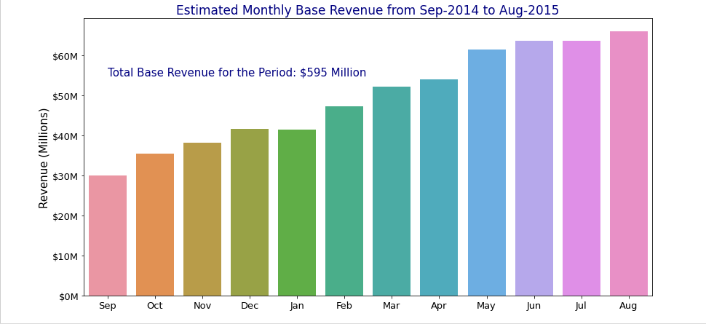
Estimated Monthly Base Revenue from Sep-2014 to Aug-2015

Slide 17
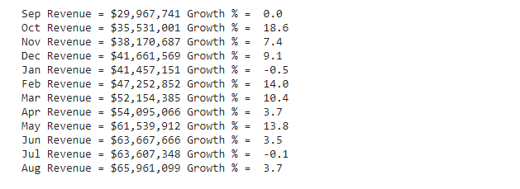
Based on the monthly revenue, what’s is the % growth?

Slide 18
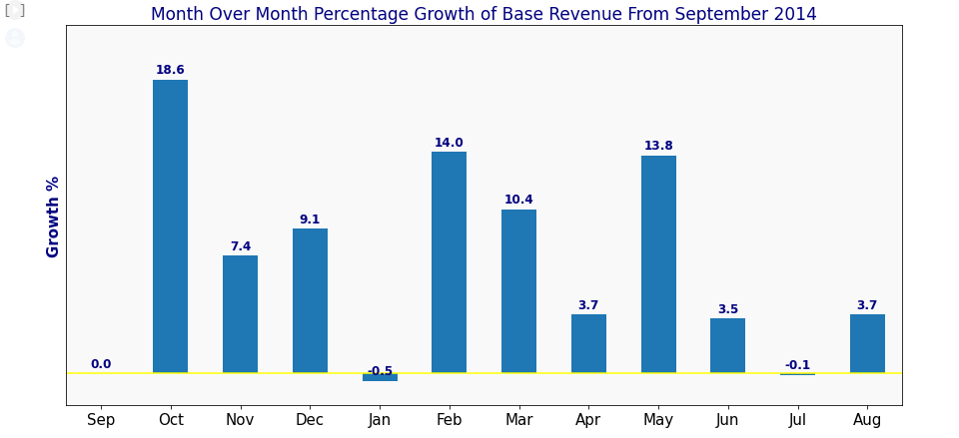
Plotting the same

Slide 19
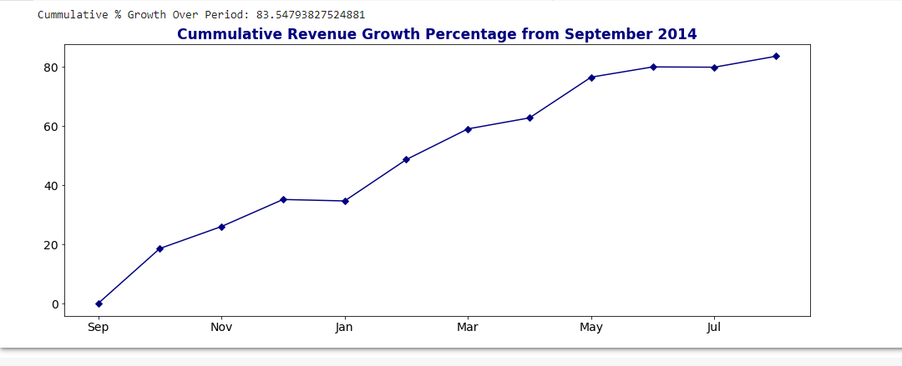
Cumulative % Growth Over Period:

Slide 20
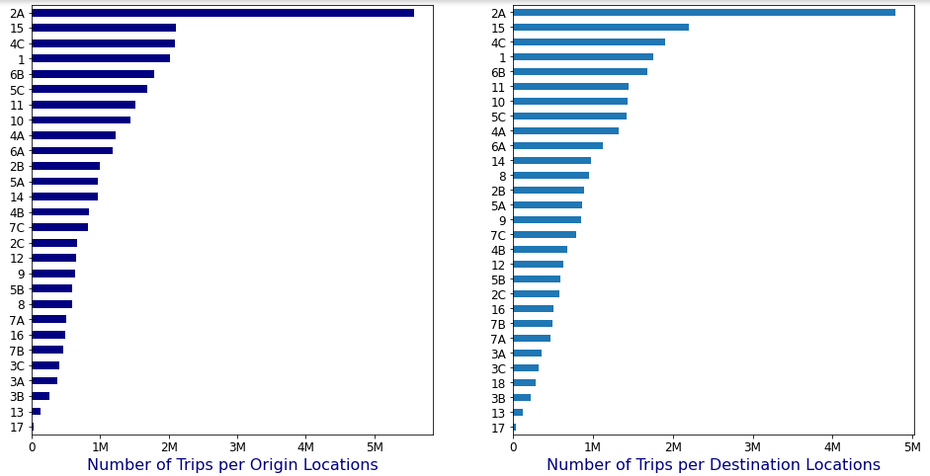
The most popular pick-up and drop-off taxi zones
Conclusion: The top location for the pick-up and drop-off is 2A.
Analyzing further, 29% of uber trips starts or finishes at 2A.

Slide 21
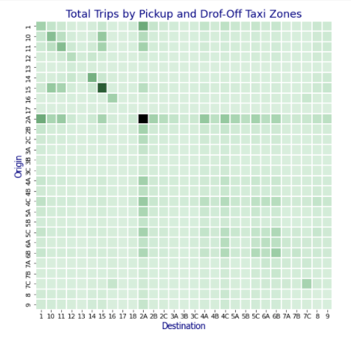
Visualizing the popular pick-up and drop-off location pairs.

Slide 22
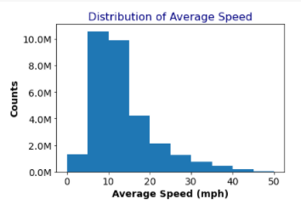
Distribution of avg. speed vs count

Slide 23
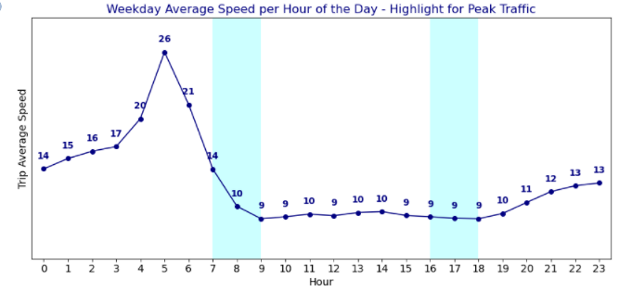
Weekday avg. speed per hour - highlighted by traffic

Slide 24
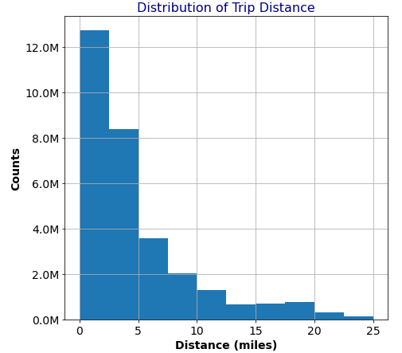
DISTRIBUTION OF TRIP DISTANCE

Slide 25
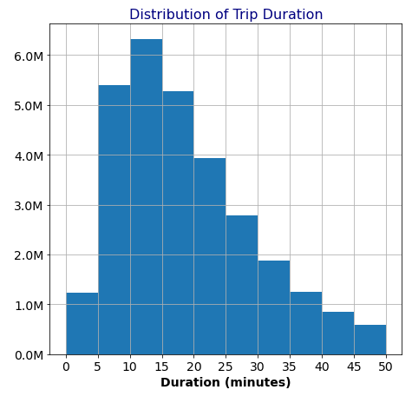
DISTRIBUTION OF TRIP DURATION

Slide 26
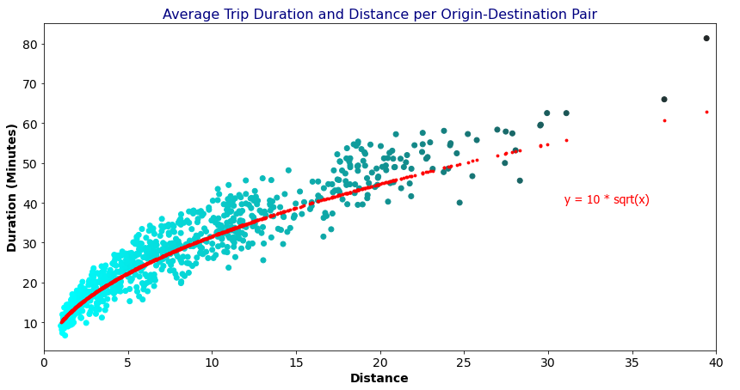
Distance vs. Duration

Slide 27
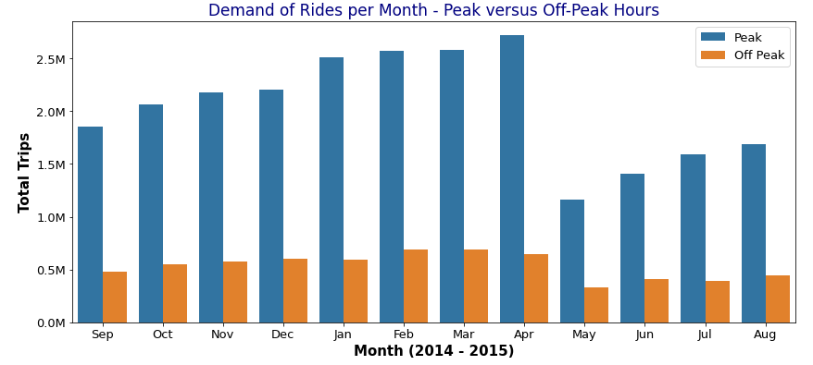
DEMANDS OF TOTAL RIDES

Slide 28
Conclusion
We aimed to expose all the interesting insights that can be derived from a detailed analysis of the dataset, without even doing any machine learning.
The peak hours calculated is helpful in predicting the taxi necessities at each hour of a day which is useful in planning the time of the taxi pickup accordingly.
we explored the uber trip data and analyzed and got the insights of avg. speed of a single trip, demand for trips per day based on the given dataset which later will help us in analyzing their marketing strategy and to compare their marketing with other taxis and cabs.
We further analyzed the popular pick-ups and drop-offs and how traffic and speed is affecting the number of trips.
Also distance covered and the time duration taken to cover it helps us gaining more insights.

Slide 29
Future work
Compare different transportation facilities and other cab companies with Uber and see which one is better?
How uber’s market is affected by the bad weather? Is it harder to get a Lyft or Uber during bad weather like thunderstorms or snow?
Compare other taxis and see how the marketing strategy of uber is different from others.

Slide 30
References
Suggestion for analyzing different things -
https://fivethirtyeight.com/features/is-uber-making-nyc-rush-hour-traffic-worse/
https://fivethirtyeight.com/features/uber-is-taking-millions-of-manhattan-rides-away-from-taxis/
https://fivethirtyeight.com/features/uber-is-serving-new-yorks-outer-boroughs-more-than-taxis-are/
For visualizations -
https://livecodestream.dev/post/how-to-build-beautiful-plots-with-python-and-seaborn/
https://www.python-graph-gallery.com/92-control-color-in-seaborn-heatmaps

